Slide 1
Industry | Phishing | Malware | DDoS | Insider Threat | Ransomware | Total Freq. across Actions
Banking | 100 | 150 | 50 | 30 | 70 | 400
Healthcare | 80 | 120 | 40 | 60 | 100 | 400
Retail | 90 | 110 | 70 | 20 | 60 | 350
Total Freq. across Industries | 270 | 380 | 160 | 110 | 350
For Each industry, normalizing incident frequencies across all attack techniques(i.e., Actions):
For Each Attack techniques(i.e. Action), normalizing incident frequencies across all Industry Sectors:
Industry | Phishing | Malware | DDoS | Insider Threat | Ransomware
Banking | 0.25 | 0.375 | 0.125 | 0.075 | 0.175
Healthcare | 0.2 | 0.3 | 0.1 | 0.15 | 0.25
Retail | 0.257143 | 0.314286 | 0.2 | 0.057143 | 0.171429
Industry | Phishing | Malware | DDoS | Insider Threat | Ransomware
Banking | 0.37037 | 0.394737 | 0.3125 | 0.272727 | 0.304348
Healthcare | 0.296296 | 0.315789 | 0.25 | 0.545455 | 0.434783
Retail | 0.333333 | 0.289474 | 0.4375 | 0.181818 | 0.26087

Slide 2
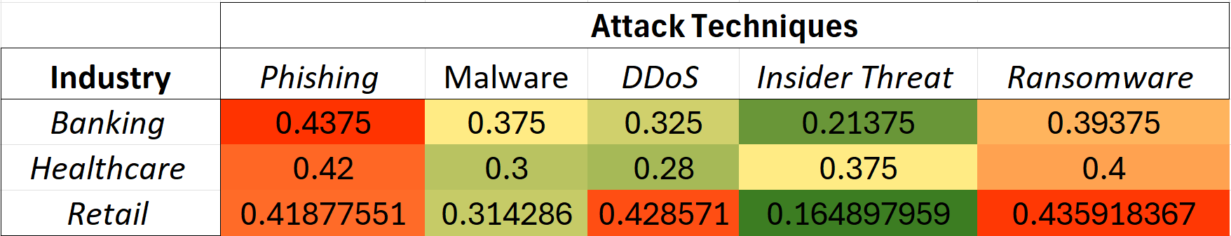
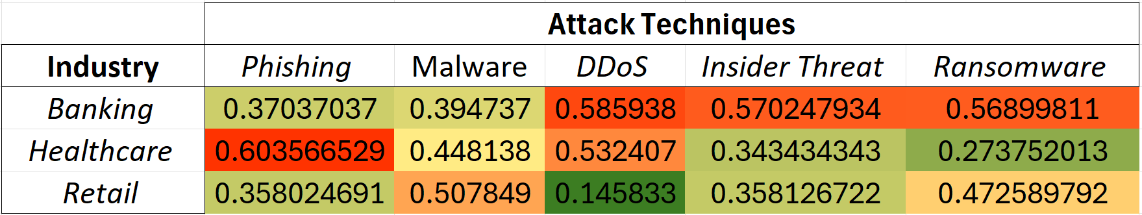
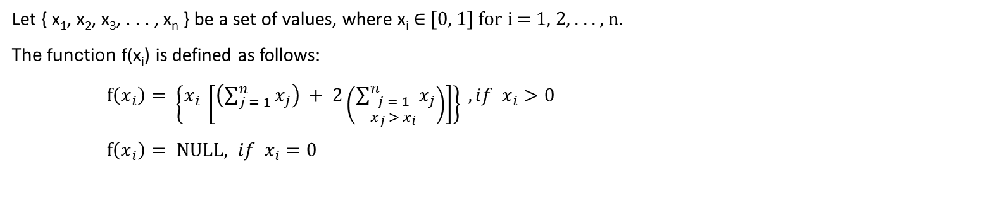
For Each industry, normalizing incident frequencies across all attack techniques(i.e., Actions):
For Each Attack techniques(i.e. Action), normalizing incident frequencies across all Industries:
Industry | Phishing | Malware | DDoS | Insider Threat | Ransomware
Banking | 0.25 | 0.375 | 0.125 | 0.075 | 0.175
Healthcare | 0.2 | 0.3 | 0.1 | 0.15 | 0.25
Retail | 0.257143 | 0.314286 | 0.2 | 0.057143 | 0.171429
Industry | Phishing | Malware | DDoS | Insider Threat | Ransomware
Banking | 0.37037 | 0.394737 | 0.3125 | 0.272727 | 0.304348
Healthcare | 0.296296 | 0.315789 | 0.25 | 0.545455 | 0.434783
Retail | 0.333333 | 0.289474 | 0.4375 | 0.181818 | 0.26087
Let { x₁, x₂, x₃, . . . , x_{n} } be a set of values, where x_{i} ∈ [0, 1] for i = 1, 2, . . . , n.
The function f(x_{i}) is defined as follows:
$f\left(x_{i}\right)= \left\{x_{i} \left[\left(\sum_{j = 1}^{n}{x_{j}}\right) + 2\left(\sum_{\begin{aligned}j = 1 \\ x_{j} > x_{i}\end{aligned}}^{n}{x_{j}}\right)\right]\right\} , if x_{i}>0$
$f\left(x_{i}\right)= \text{NULL}, if x_{i}=0$
Industry | Phishing | Malware | DDoS | Insider Threat | Ransomware
Banking | 0.25[1 + 2(0.375)] | 0.375[1 + 2(0)] | 0.125[1 + 2(0.25+0.375+0.175)] | 0.075[1 + 2(0.25+0.375+0.125+0.175)] | 0.175[1+ 2(0.25+0.375)]
Healthcare | 0.42 | 0.3 | 0.28 | 0.375 | 0.4
Retail | 0.418776 | 0.314286 | 0.428571 | 0.164898 | 0.435918
Industry | Phishing | Malware | DDoS | Insider Threat | Ransomware
Banking | 0.37037[1 + 2(0)] | 0.394737 | 0.585938 | 0.570248 | 0.568998
Healthcare | 0.296296[1 + 2(0.37037+0.333333)] | 0.448138 | 0.532407 | 0.343434 | 0.273752
Retail | 0.333333[1 + 2(0.37037)] | 0.507849 | 0.145833 | 0.358127 | 0.47259

Slide 3
SOLUTION ARCHITECTURE
Compilation of General and Industry-specific LLM Attack Techniques
Cybersecurity Attack Techniques Identified by
VERIS schema (Vocabulary for Event Recording and Incident Sharing)
VCDB (VERIS Community Database-filtered)
MITRE ATLAS (Adversarial Threat Landscape for Artificial-Intelligence Systems)
LLM Attack Techniques(Ind spec) via Literature Survey & Web-Scarping
VCDB (VERIS Community Database-filtered)
SUSB (Statistics of U.S. Businesses Datasets) Census Dataset
VCDB (*Filtered by LLM Attack techniques)
NAICS (North American Industry Classification System) codes for industry sectors with corresponding business counts and average sizes (over years).
LLM Attack Techniques categorized by tactic (motive)
United States Incidents
Similarity
Data insights
Frequency Analysis of Vulnerabilities across Industries
Construct a Risk Assessment Framework

Slide 4
SUMMARY
KEY TAKEAWAYS AND INSIGHST
INCEPTION
The study introduces a security and risk perspective on Large Language Model.
MAPPING
A pivotal step of mapping of VERIS and MITRE ATLAS, we deduced potential LLM attack types across all industries.
Integration, pre-processing, exploratory analysis of the datasets shed light on quantifiable measures of cyber security incidents.
The risk framework provides a foundation and a crucial step to measure vulnerabilities across NAICS industries. Education and Finance are the most vulnerable industries to LLM attacks.
LITERATURE SURVEY
Referring to a considerable number of resources, we gathered information on LLM attack incidents.
DATASETS AND FRAMEWORKS
Introduction of notable data resources such as to VERIS, MITRE ATLAS, and CENSUS (SUSB) provided evidence on multiple cyber security incidents.
Incorporating the CENSUS data, we provided risk visualization across US states for all businesses and industries. States such as California, Texas, and New York are prone to attacks.

Slide 5
Summary: Key Takeaways and Insights
Developing a risk framework as a foundation and a crucial step to measure vulnerabilities across NAICS industries.
Education and Finance are the most vulnerable industries to LLM attacks.
Incorporating the CENSUS data, we provided risk geographical visualization across US states for all businesses and industries.
States such as California, Texas, and New York are prone to attacks.

Slide 6
References
https://www.upguard.com/blog/how-to-perform-a-cyber-risk-analysis#:~:text=Cyber%20risk%20is%20calculated%20by,x%20Vulnerability%20x%20Information%20Value.
SMB Profiling Method by Dr C. Rasmussen

Slide 7
Thank You!

Slide 8
Appendix

Slide 9
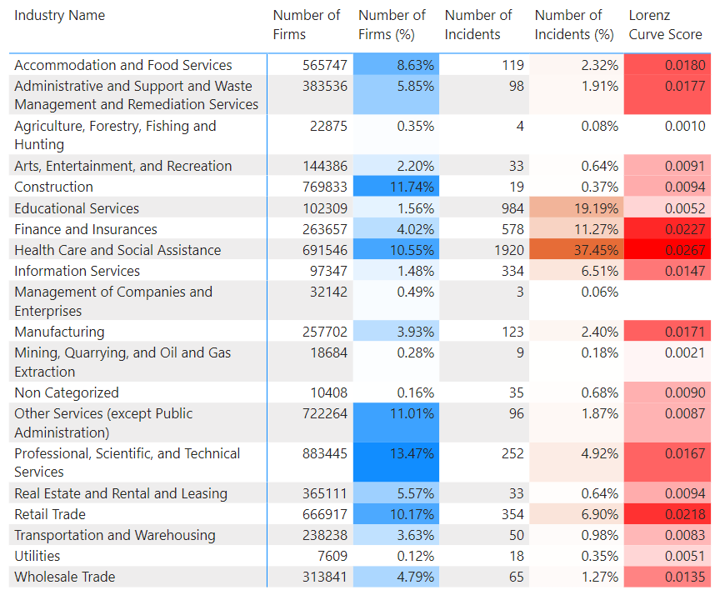
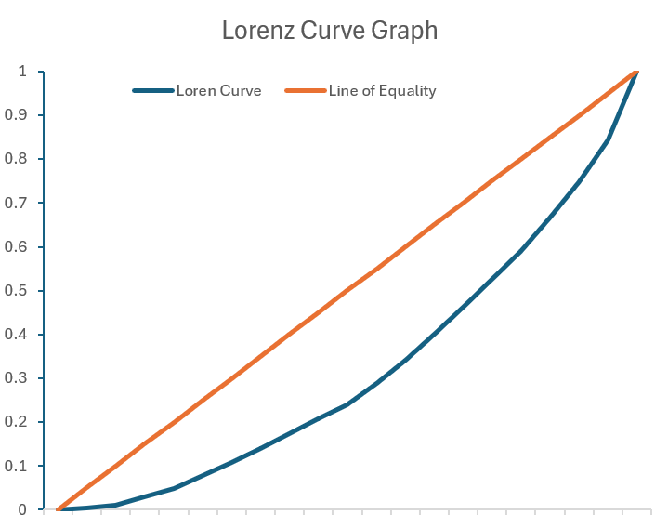
GINI INDEX ON AGGREGATED VERIS & CENSUS DATASET (2020-2023)
High Level – Risk Score
LLM Meta Prompt Extraction
Gini Index = 1 - Sum of Lorenz Curve Score
= 0.72

Slide 10
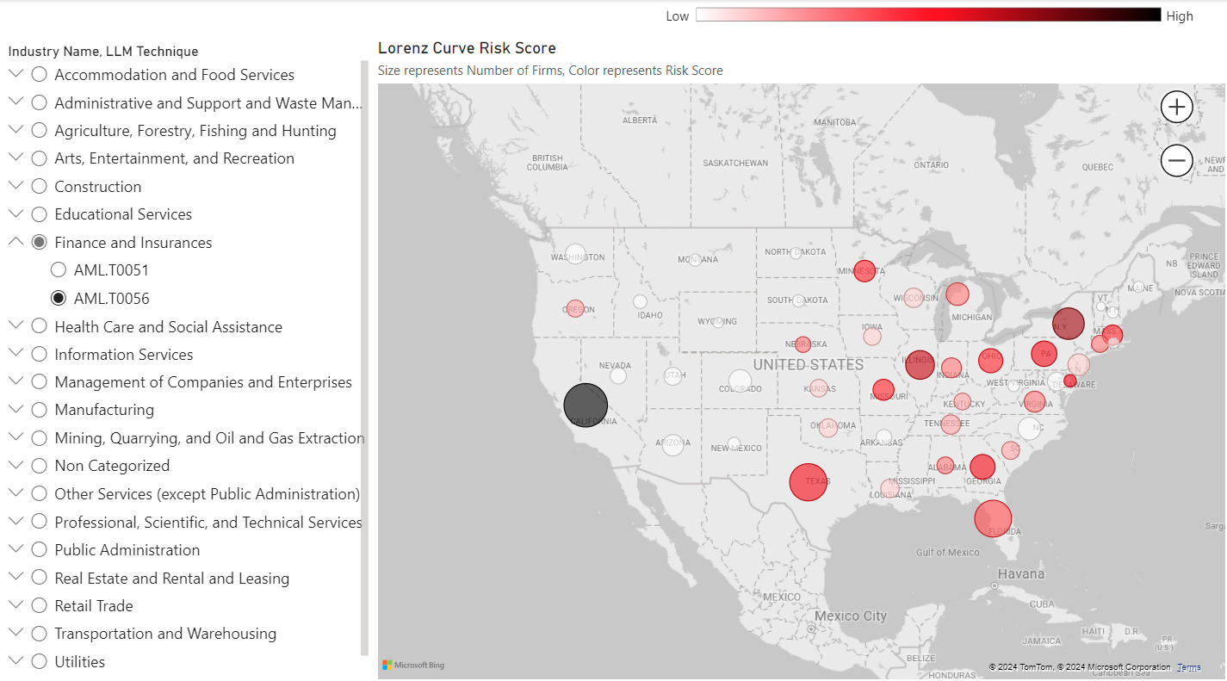
GINI INDEX ON AGGREGATED VERIS & CENSUS DATASET (2020-2023)
Low Level – Risk Score (by State)
LLM Meta Prompt Extraction

Slide 11
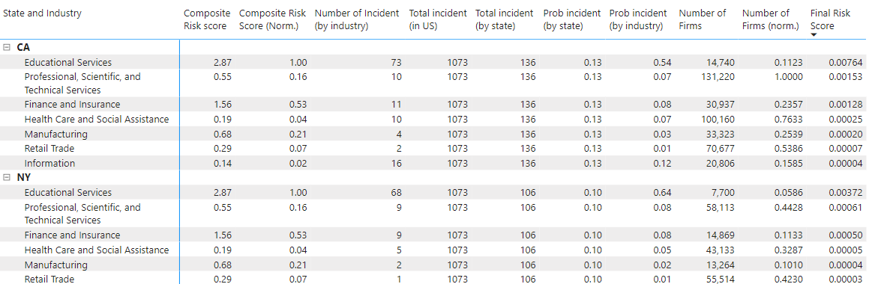
Final Risk score (2020-2023)
Final Risk Score =
Composite Risk Score (norm) x Prob. Incident by state x Prob. Incident by Industry x Number of Firms (norm)
x 1,000,000
=>
=>
Total incident in state Incident in specific industry in state
Total incident in US Total incident in state
NAICS Code
VERIS DATA
CENSUS DATA

Slide 12
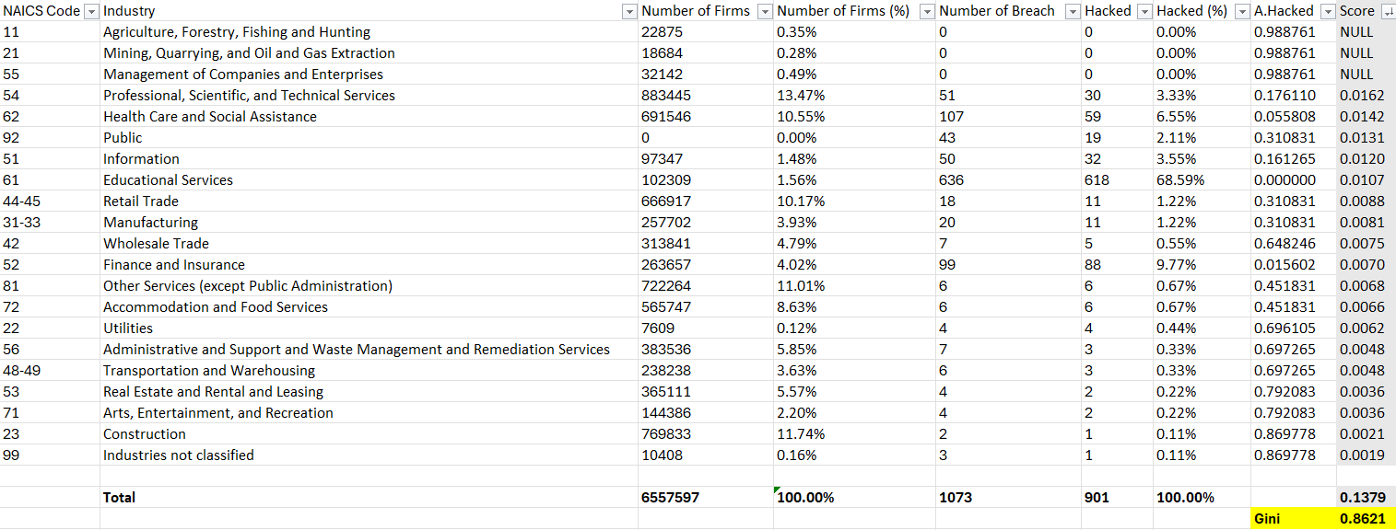
GINI INDEX ON AGGREGATED VERIS & CENSUS DATASET (2020-2023)
High Level – Risk Score
NAICS Code
CENSUS DATA
VERIS DATA
RISK SCORE
Next Action: Incorporate MITRA ATLAS framework on the Gini index Calculation.

Slide 13
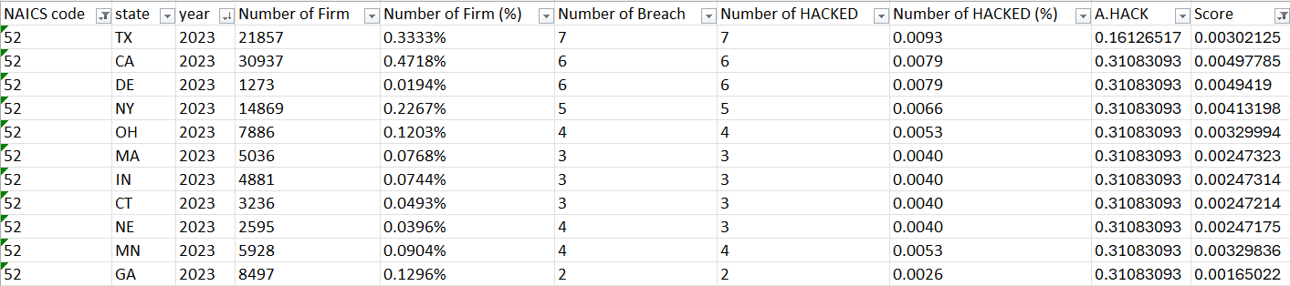
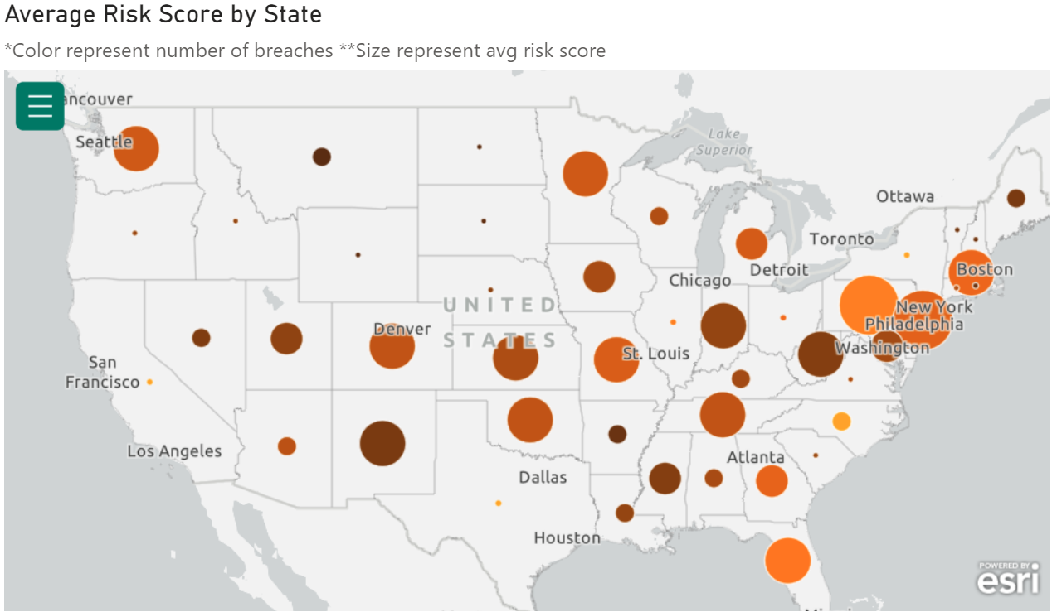

GINI INDEX ON AGGREGATED VERIS & CENSUS DATASET (2020-2023)
Low Level – Risk Score (by State)
Final Geographical Visualization:

Slide 14
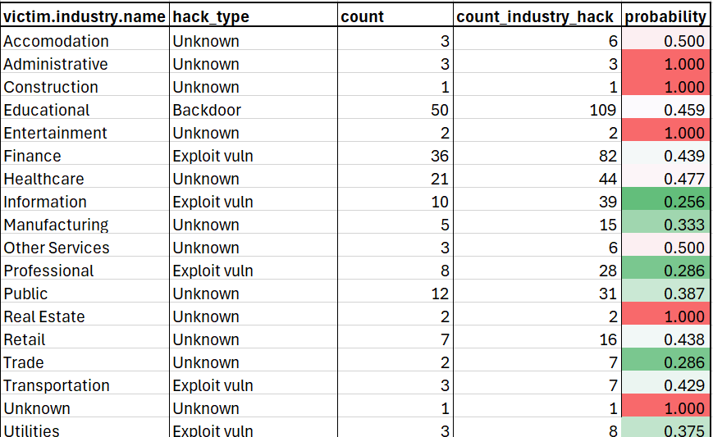
Probability FOR RISK ANALYSIS
- Probability of action→ hacking techniques for incidents through the year 2020-present.
Type of hacking attack occurring the most

Slide 15
RISK ANALYSIS BASED ON PROBABILITY OF ACTIONS OCCURING
Risk profile showing all range of actions such as hacking, malware, physical, social, misuse, and error.
Score is based on probability of the type of attack occurring the most.
Probability of 1 → number of attack type and total number of attacks are same.
Example: Physical theft in Healthcare with probability of 1 → number of physical attack = theft attack in healthcare.
These are the probability based on the fact the action for each type was recorded i.e. The value within columns such as action.Hacking, action.Misuse, and so on were “TRUE.”
Further progress: adding actors, assets, and attributes

Slide 16
Probability of Attribute variety
Confidentiality: Medical and personal (address, credit scores etc)
Integrity: software installation across all industries
Availability: Obscuration and loss

Slide 17
Probabilities of asset classes and overall impact ratings

Slide 18
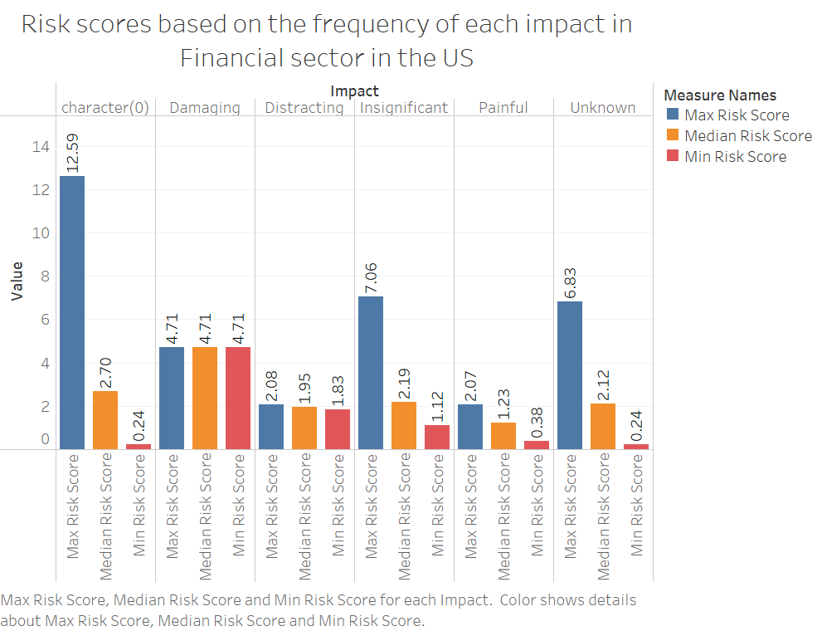
RISK SCORES BASED ON FREQUENCY
Risk calculation based on frequency:
Normalized frequency of each Assets= ‘asset_norm’
Normalized frequency of each Action=
‘action_norm’
Assumption: Attributes essentially occur after the attack is initiated. Here we will consider only the asset affected and the attack taken place.
Formula:
(only based on frequency)
Risk score= (sum of asset_norm freq) x
(sum of action_norm freq)

Slide 19
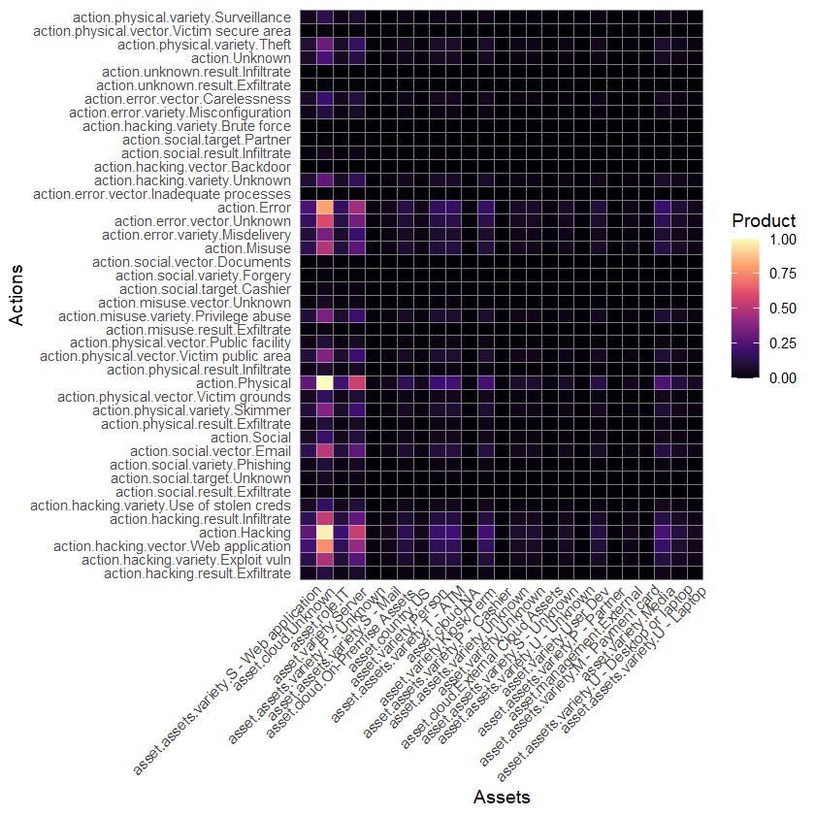
RISK HEAT MAP: ASSETS vs actions (for incidents with measured impact levels)
The heat map shows the possibility of higher risk based on asset and the action normal frequencies.
If noticed closely, the asset with ‘cloud’ framework or system is the most affected with:
Hacking
Exploitation
Physical
Social via email
And unknown error vectors
Similarly, ‘server’ as an asset is affected the most as well with actions similar to cloud system.
Product= (asset_norm freq) x (action_norm freq)

Slide 20
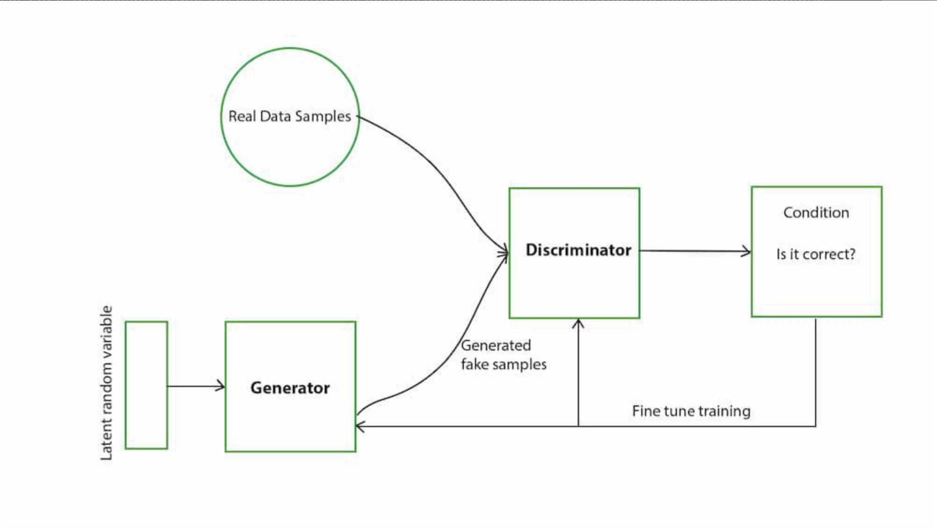
SYNTHETIC DATA
GAN – Architecture
Architecture Flow Chart

Slide 21
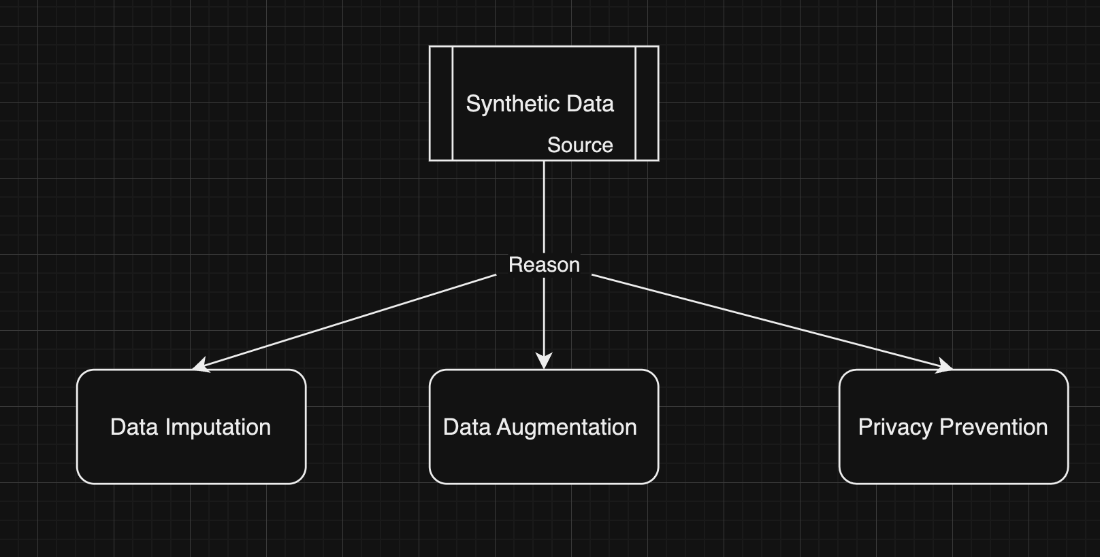
Synthetic data
Synthetic data provides a valuable tool for various applications where access to large, diverse, and privacy-respecting datasets is crucial.

Slide 22
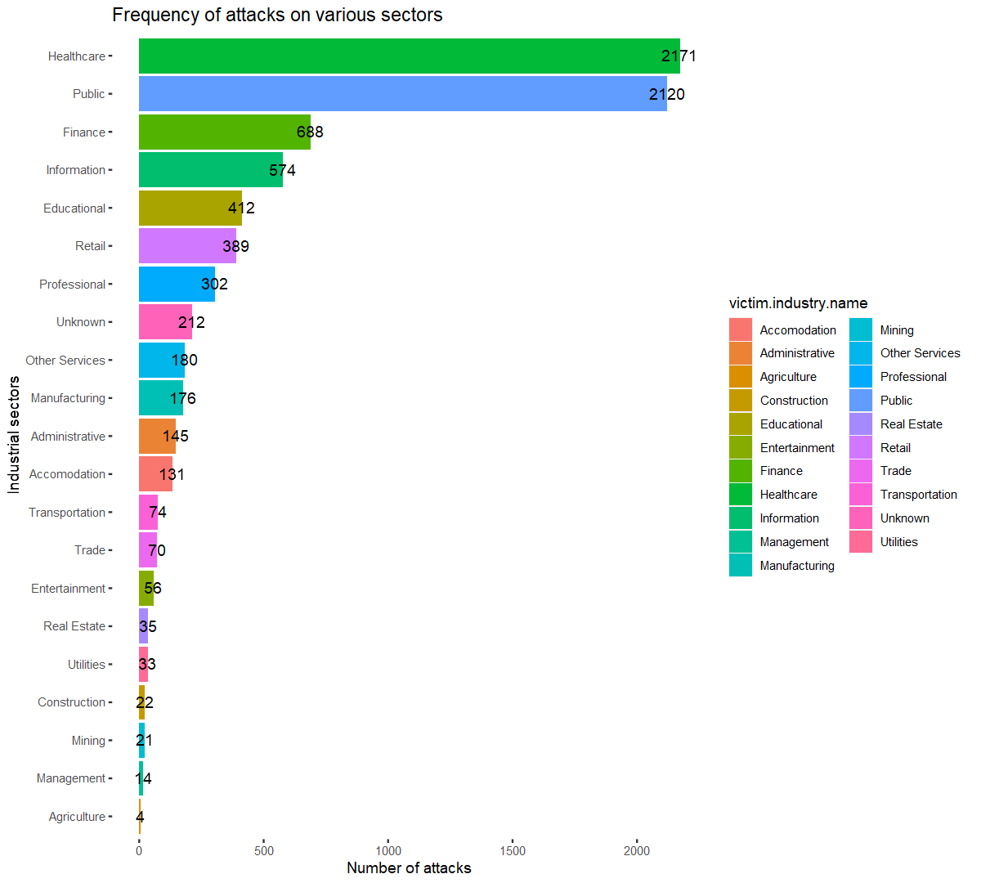
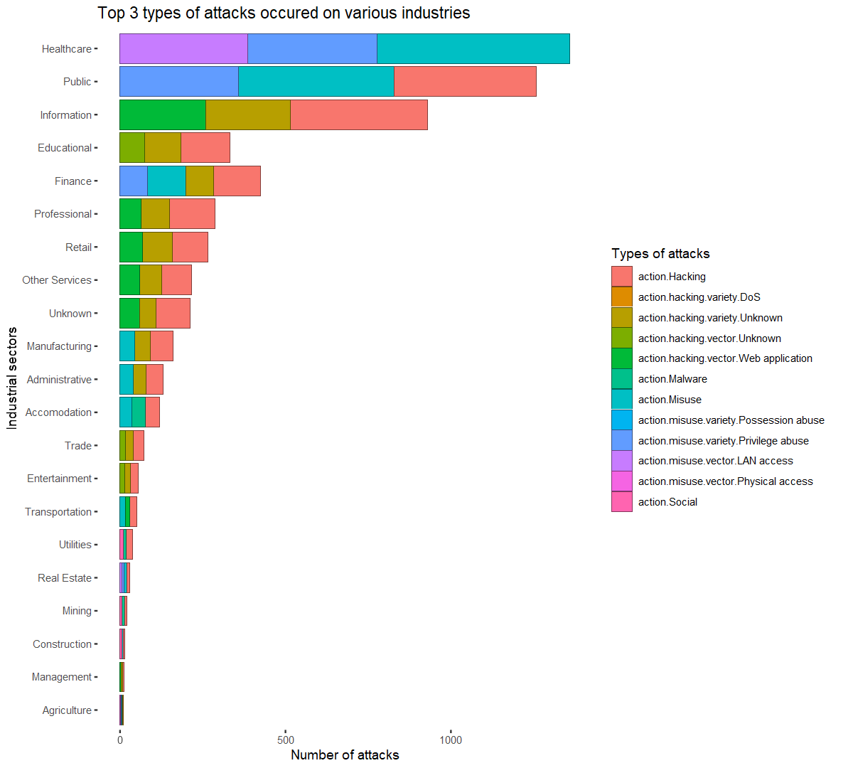
Exploratory data analysis

Slide 23
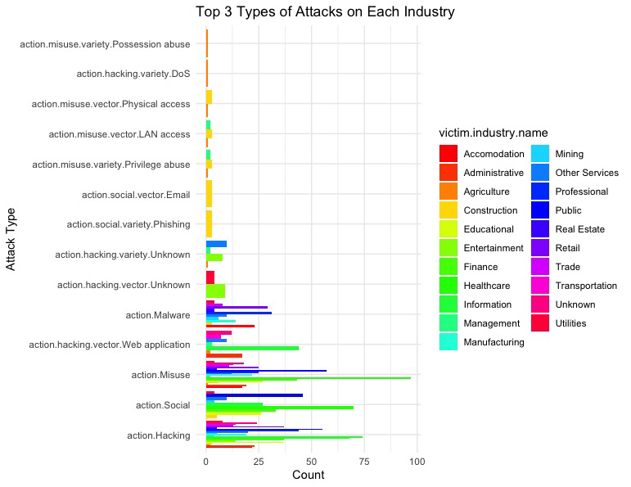
Exploratory data analysis
which type of attack harms the industry most

Slide 24
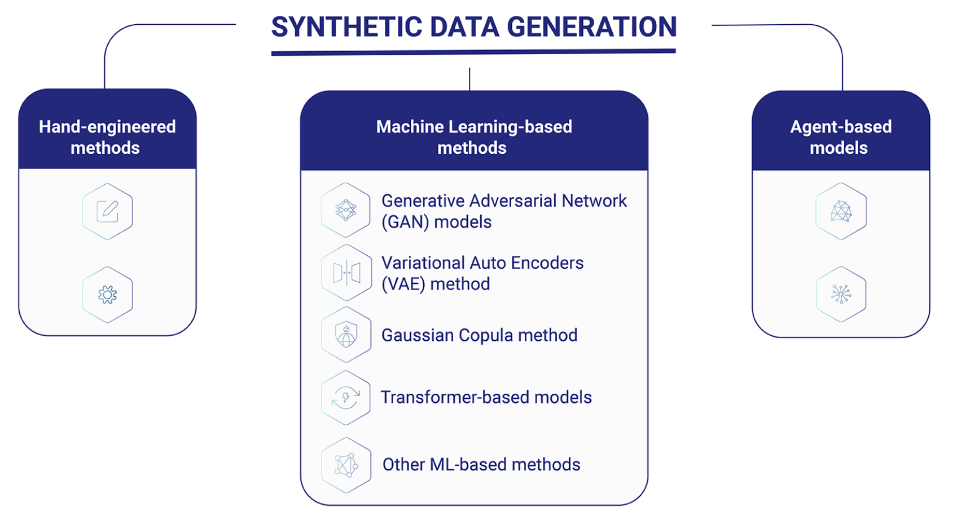
Synthetic data
METHOD
A few methods to implement
GAN - GAN synthetic data refers to data that is generated using Generative Adversarial Networks (GANs), a type of deep learning model. The generator learns to produce synthetic data that is increasingly indistinguishable from real data.
VAE - VAE stands Variational Autoencoder. (ANN for unsupervised learning). VAEs are particularly effective in generating new data samples like the ones they were trained on.
SMOTE - SMOTE stands for Synthetic Minority Over-sampling Technique. SMOTE is a data augmentation technique commonly used in the field of machine learning, particularly in scenarios where there is a class imbalance problem.

Slide 25
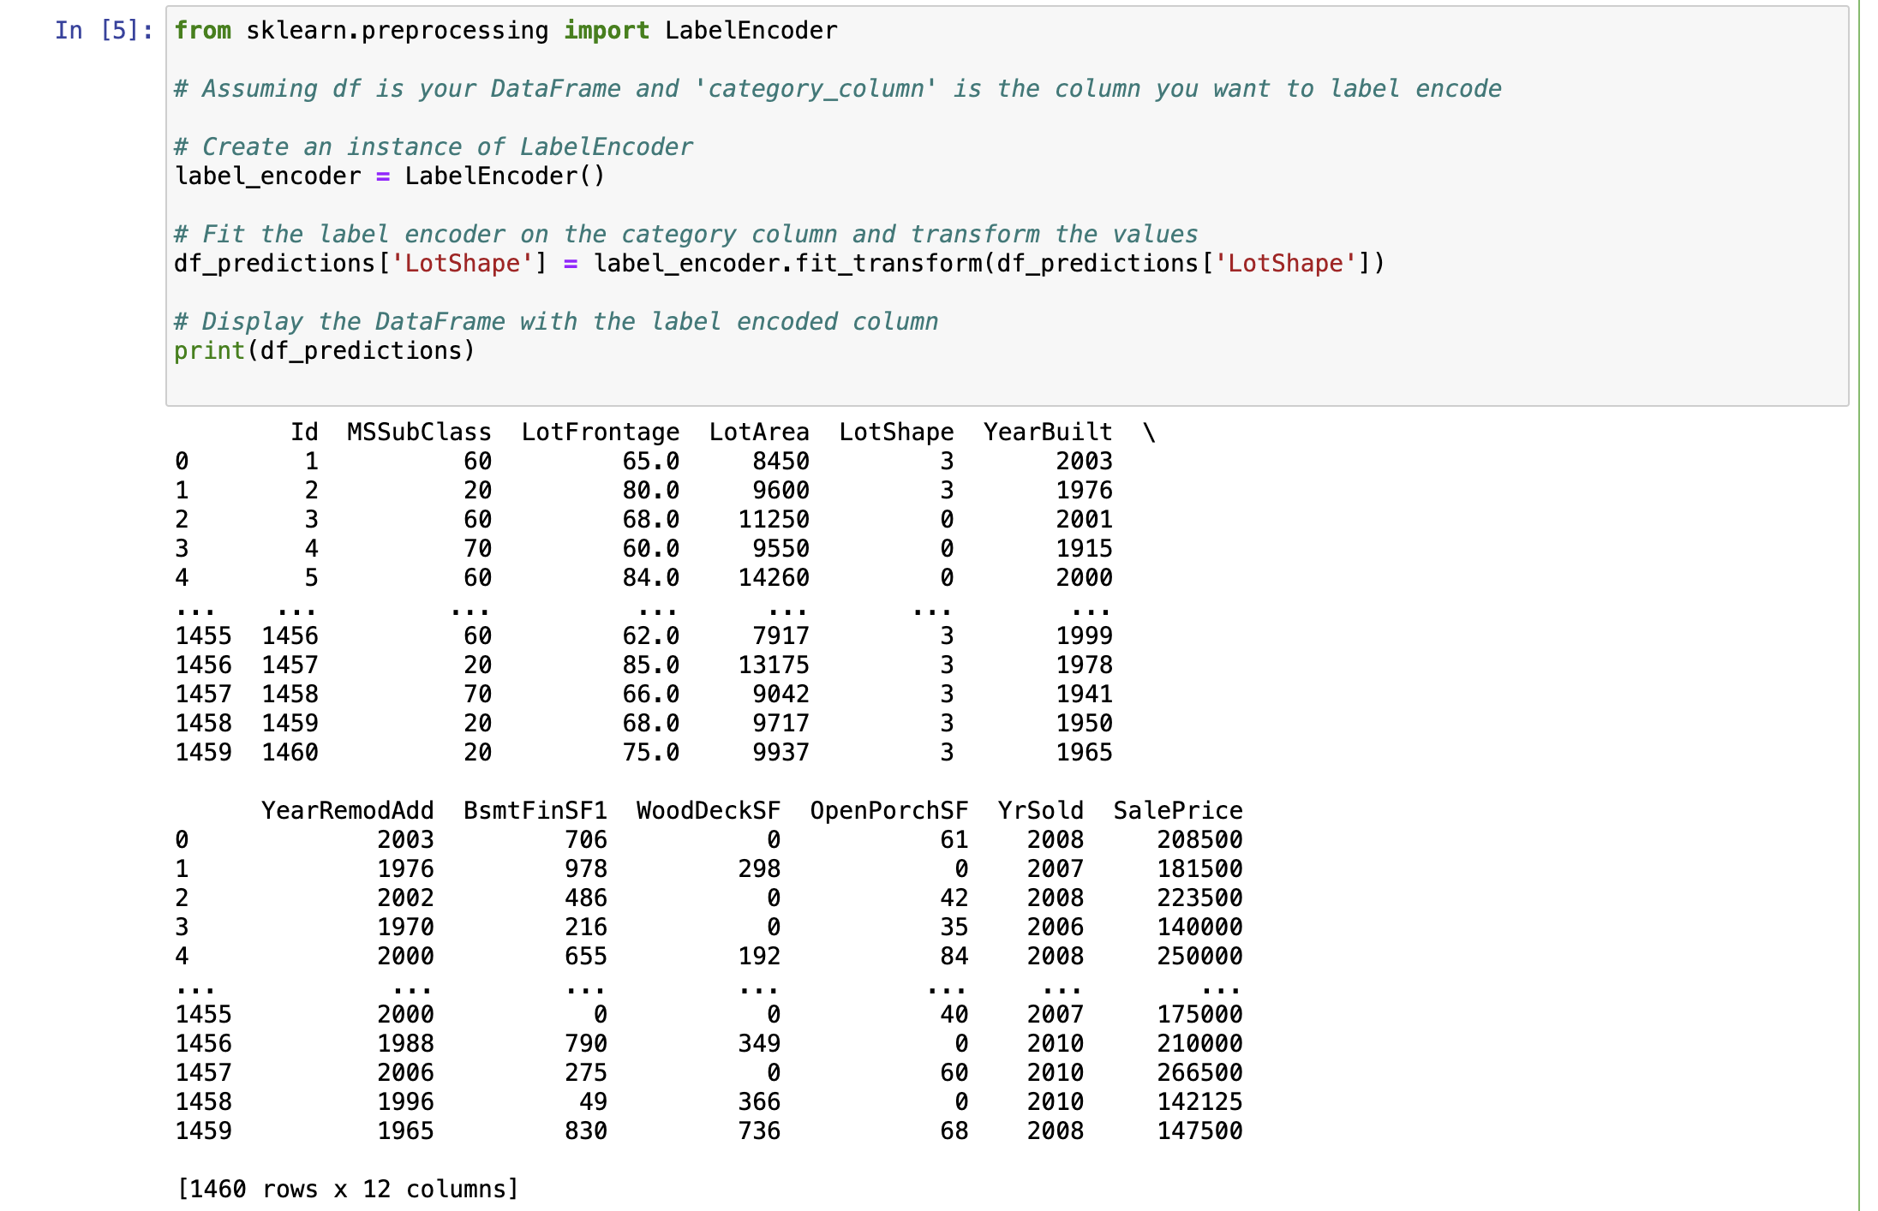
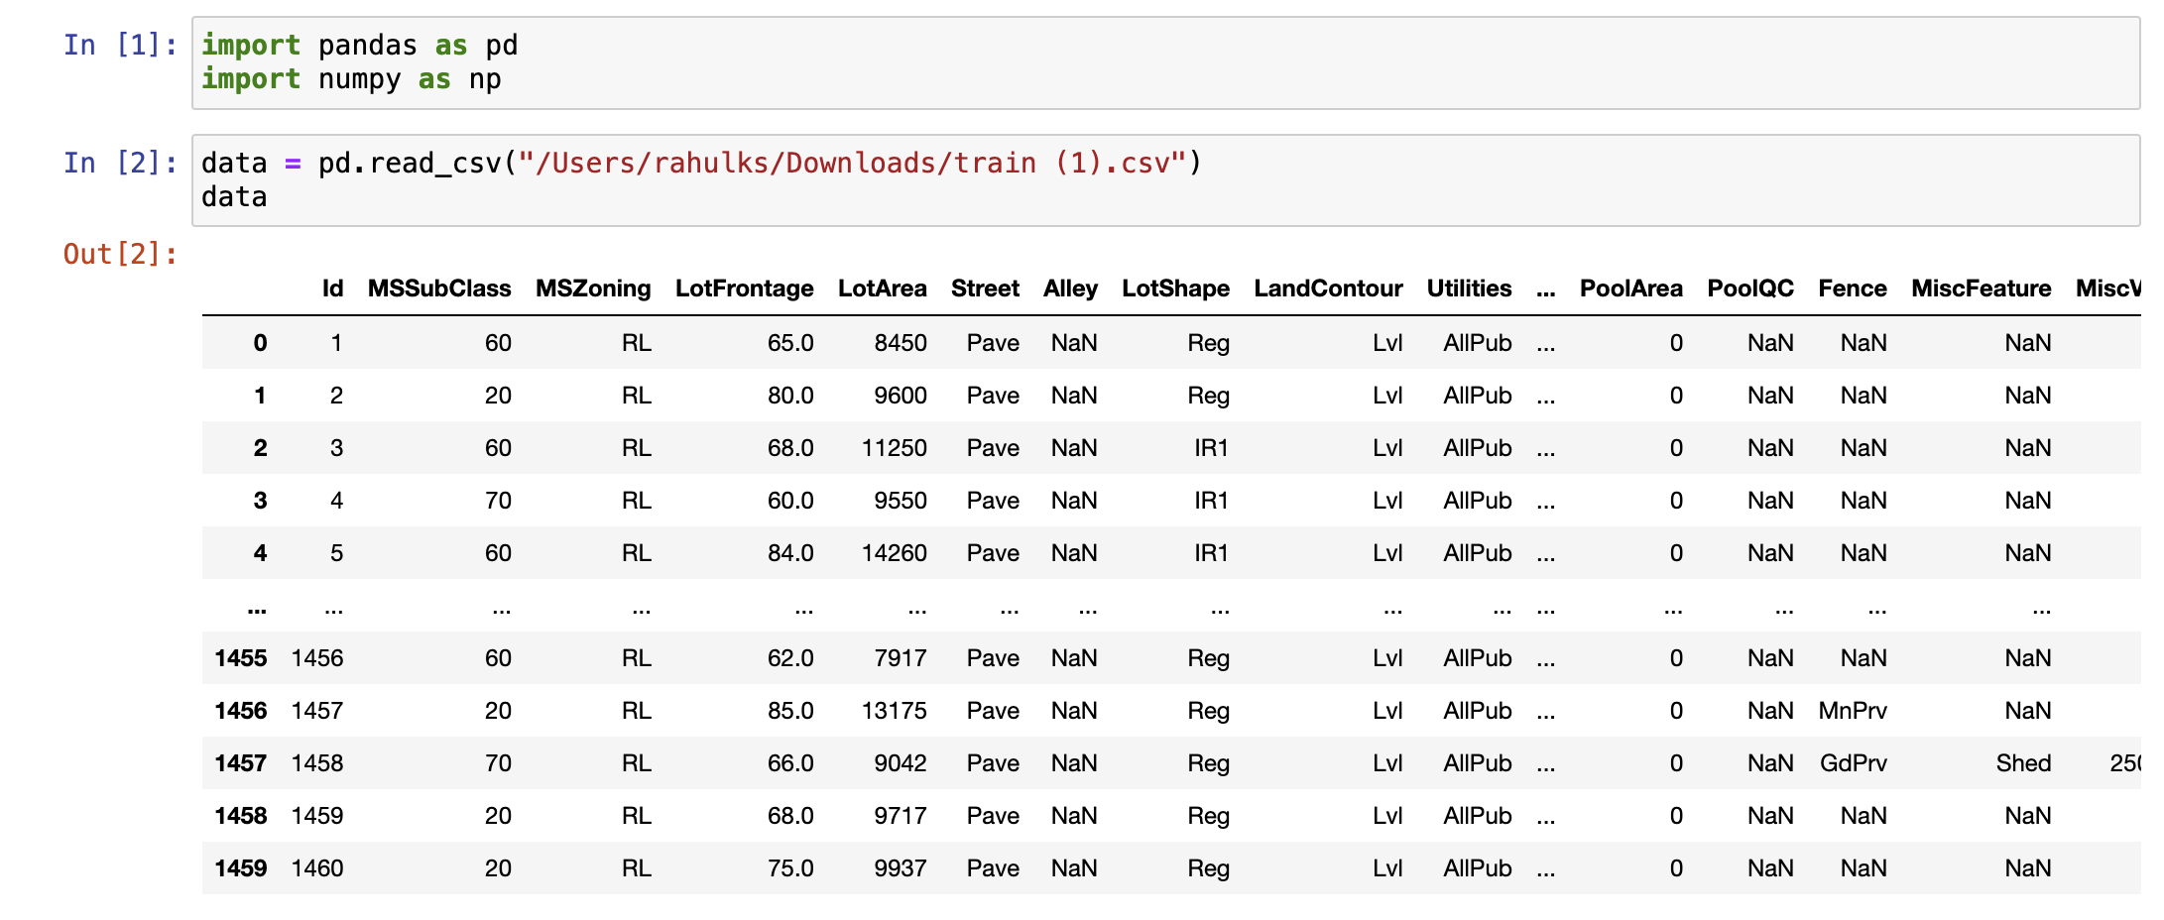
SYNTHETIC DATA
PROCESS
Performing Predictive analysis on a sample dataset
Label Encoding

Slide 26
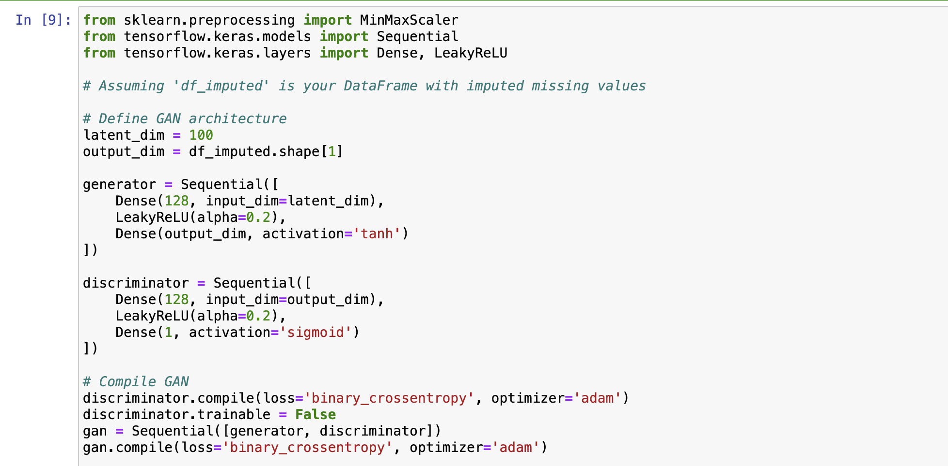
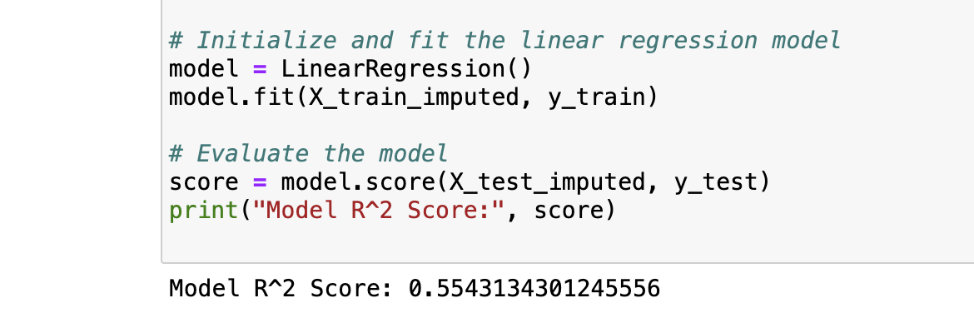
SYNTHETIC DATA
LINEAR REGRESSION
Fitting a model to the manually imputed data
Defining GAN architecture and compiling

Slide 27
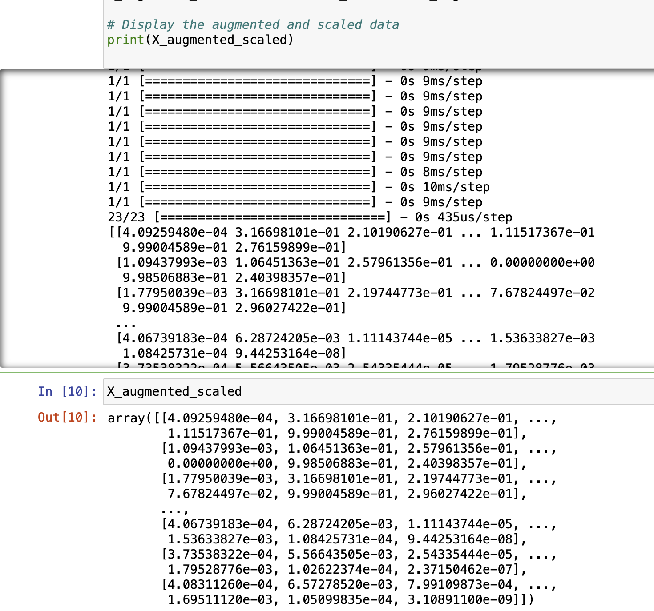
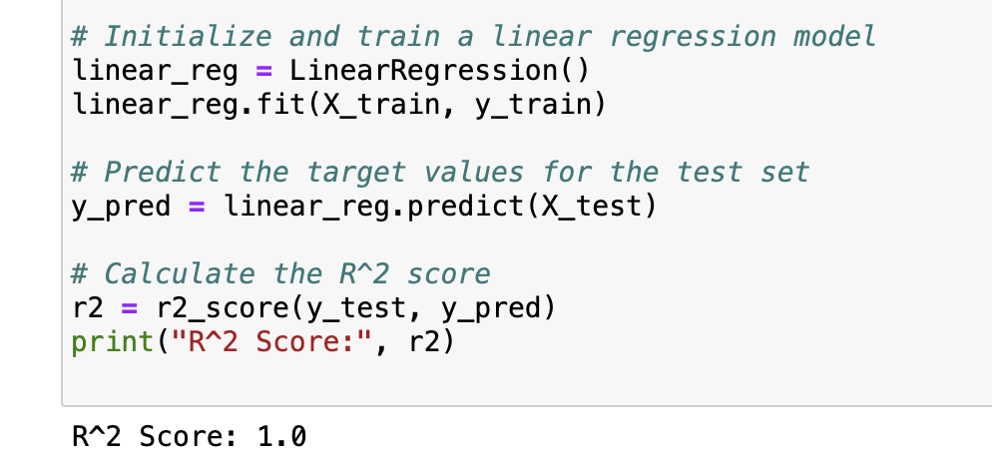
SYNTHETIC DATA
GAN RESULTS
Regression on augmented dataset
Epoch = 1000 ( Augmented data )

Slide 28
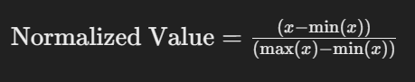
INTIAL STEPS OF RISK ANALYSIS
ASSUMPTIONS and CONSIDERTAIONS:
For simplicity and initial process of calculations, we are considering only ‘Financial Sector.’
We are assuming that irrespective of an actor, an asset within an industry is liable to cyber impact based on the type of attack, the asset attacked, the overall impact level, and the attributes.
Frequency of Attacks, Attributes, and Assets using normalization.
-Why normalization?
Standardized distribution.
Ranges from 0-1.
Features with larger and lower magnitude stay in same scale.

Slide 29
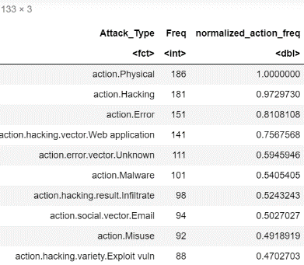
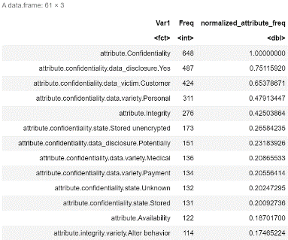
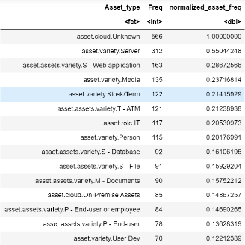
NORMALIZING ASSETS, ACTIONS, AND ATTRIBUTES DISTRIBUTION
Why frequency?
Entities with highest number of appearances may give higher chances of identifying asset and mitigate impact.
The frequency may reveal the sustainability of the asset given the number of attacks.
More attacks leads to knowing more about the susceptibility of industries.
Normalized attack frequency:
Normalized attribute frequency:
Normalized asset frequency

Slide 30
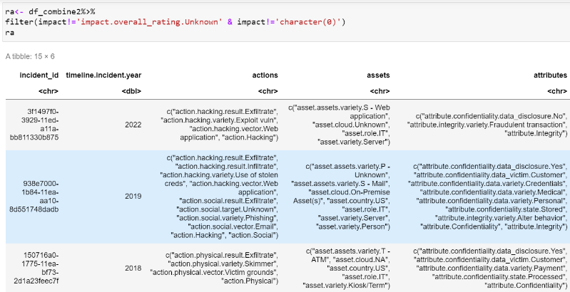
DATA SUBSETs
Data subset showing the type of attacks on various assets and the attributes considering the impact is measured and known:
Result:
15 incidents within financial industries were detected with measured overall_impact.
Multiple attacks are conducted on multiple assets. This contributes to various attribute types.

Slide 31
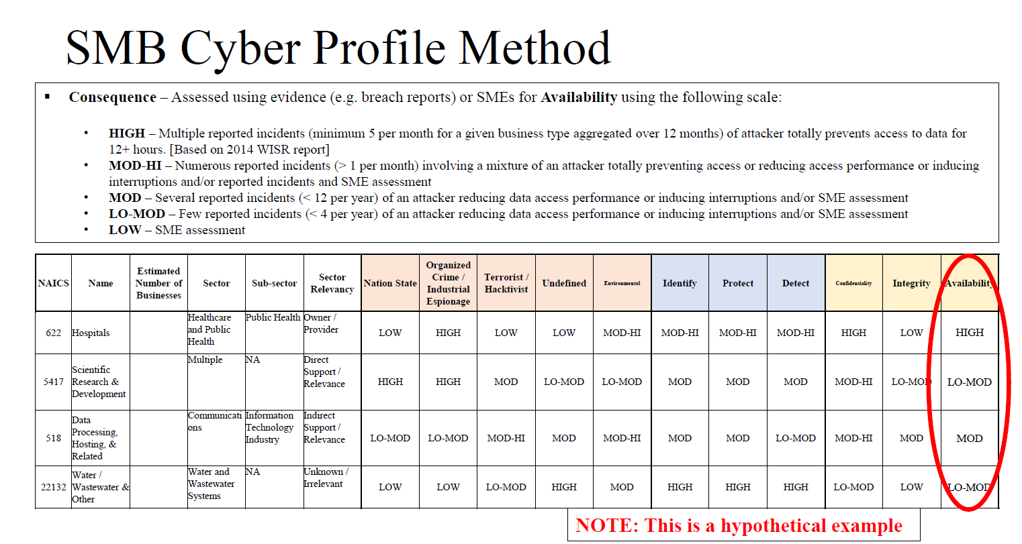
SMALL MEDIUM BUSINESS (SMB)- CYBER PROFILING METHOD
Source: SMB Cyber Profile Method by Dr. Curt Rasmussen

Slide 32
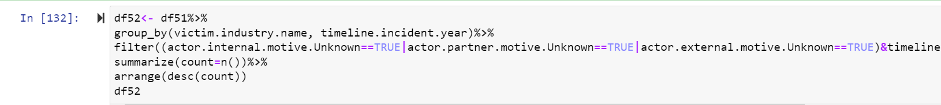
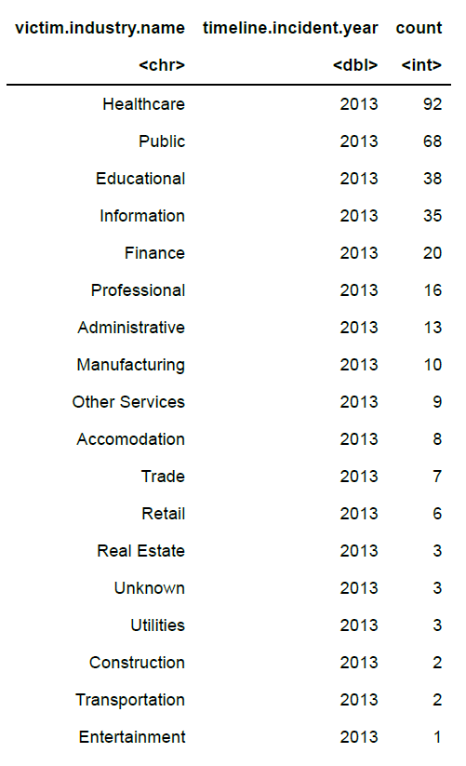
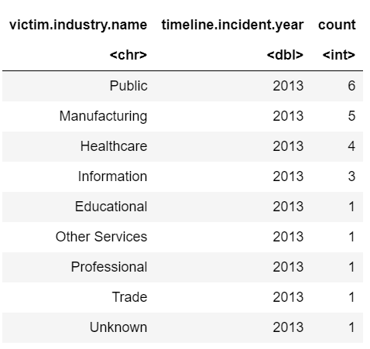
CYBER PROFILING METHOD: VERIS DATA EXPLORATION
Total Attacks Based On “UNKNOWN” Motivation:
Total Attacks With “ESPIONAGE” Motivation:

Slide 33
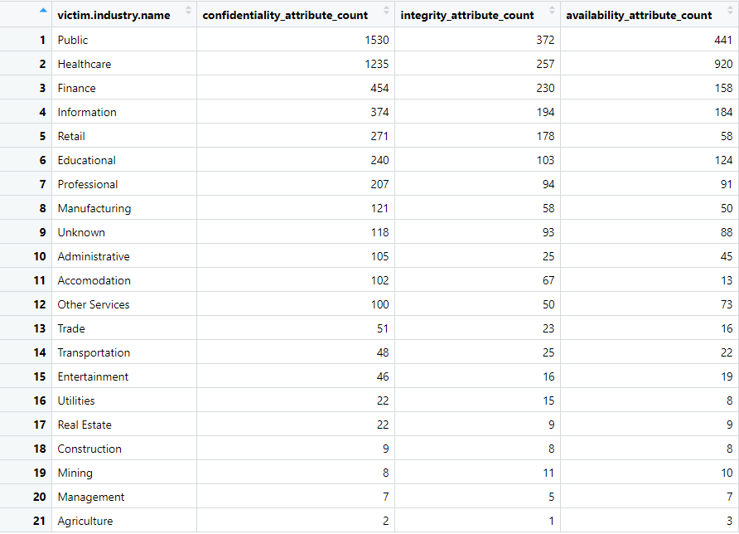
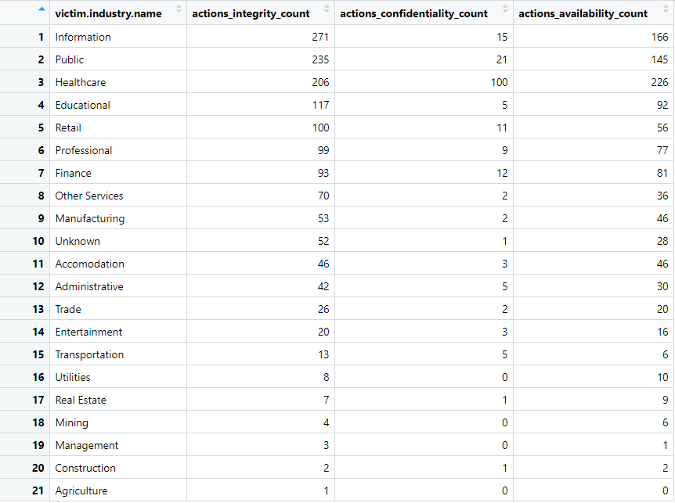
Consequences:
The data wasn’t confidential anymore.
The data couldn’t generate the expected/appropriate responses.
The data isn’t available anymore.
CYBER PROFILING METHOD: PROGRESS SO FAR
CYBER PROFILING METHOD: VERIS DATA EXPLORATION

Slide 34
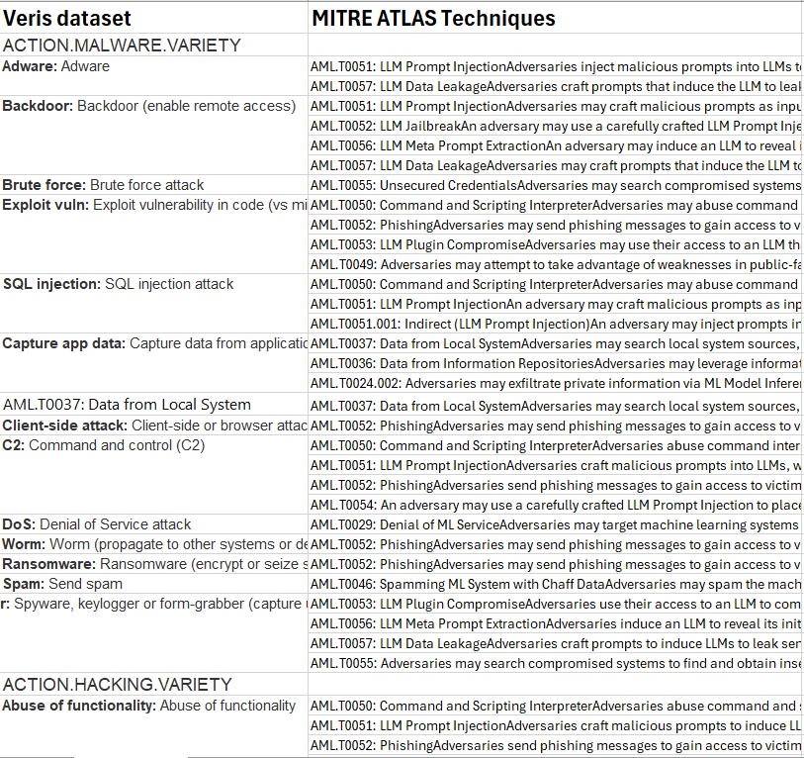
Mapping mutual attack techniques from mitre atlas to veris

Slide 35
Mapping mutual attack techniques from mitre atlas to veris
LLM Prompt Injection (AML.T0051)
Phishing (AML.T0052)
ACTION.HACKING.VARIETY. XPath injection
ACTION.HACKING.VECTOR. 3rd party desktop
Unsecured Credentials (AML.T0055)
ACTION.MISUSE.VARIETY. Unapproved software
ACTION.HACKING.RESULT. brute force
ACTION.MALWARE.VARIETY.C2
ACTION.SOCIAL.VARIETY. Baiting
ACTION.MALWARE.VARIETY. Brute force
Command and Scripting Interpreter (AML.T0050)
ACTION.HACKING.VARIETY. Abuse of functionality
ACTION.HACKING.VARIETY. LDAP injection
Backdoor ML Model (AML.T0018)
ACTION.HACKING.VECTOR. Backdoor or C2
Exploit Public-Facing Application (AML.T0049)
ACTION.HACKING.VARIETY. URL redirector abuse
ACTION.HACKING.VARIETY. Cache poisoning
ACTION.HACKING.VARIETY.CSRF
ACTION.HACKING.VARIETY.Reverse engineering
ACTION.MALWARE.VARIETY.Backdoor
ACTION.SOCIAL.VARIETY. Baiting. Bribery
ACTION.HACKING.VARIETY. XSS
ACTION.HACKING.VARIETY. Use of backdoor or C2
ACTION.MALWARE.VARIETY.Spyware/Keylogger
ACTION.HACKING.VARIETY. OS commanding
ACTION.HACKING.VARIETY.SQLi
ACTION.MALWARE.RESULT. Capture stored data
Mitre Atlas Techniques
Veris Action Attacks

Slide 36
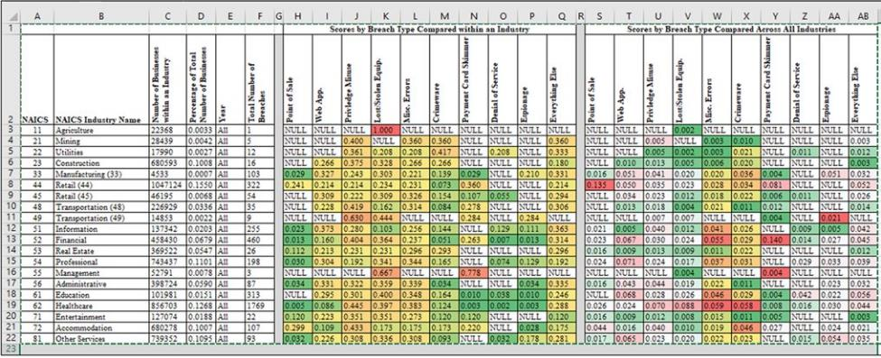
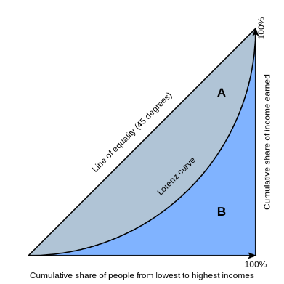
Application of Lorenz's Curves for Risk Profiling
Gini Index : (A)/(A+B)

Slide 37
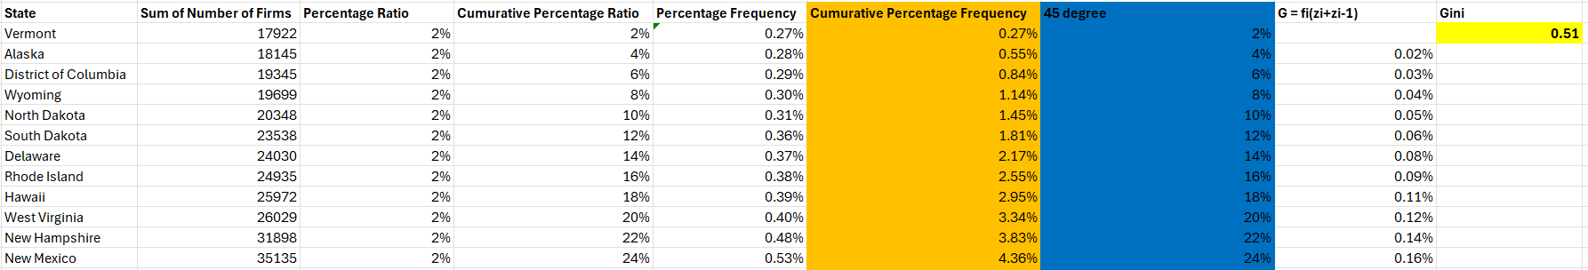
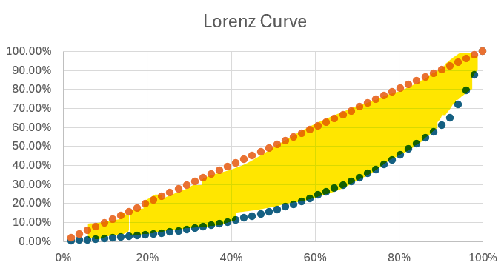
Lorenz Curve & GINI INDEX

Slide 38
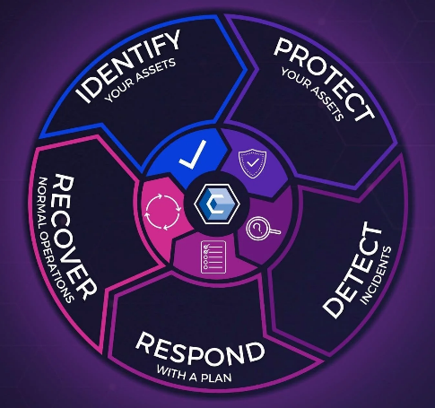
UNDERSTANDING CYBER SECURITY
Stage-1: Identify- Know your system, assets, and adversaries who may attack. Be vigilant!
Stage-2: Protect- Take steps to defend your data. Limit the impact of an attack.
Stage-3: Detect- Discovering breaches and always assume that attack/breach is inevitable.
Stage-4: Respond- Get hold of the attack and mitigate the impact. Halt lateral movement in the network.
Stage-5: Recover- Set up network system, restore functionality. Use back-up systems (if available) for normal operation.

Slide 39
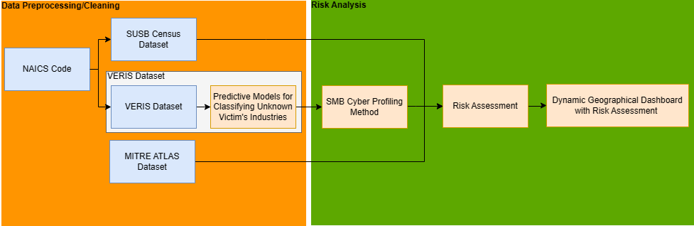
RISK ASSESSMENT FRAMEWORK

Slide 40





Data Ingestion and Cleaning Using Mongodb
Workflow Paradigm
Github.com/vz-risk/VCDB
Data Source
Submitted
Data Ingestion
Mining Insights
Validated
Overridden
10,262 incidents(as .json files)
*As of 23rd Jan 2024
Data Cleaning
Post Cleaning: 10085 incidents.

Slide 41
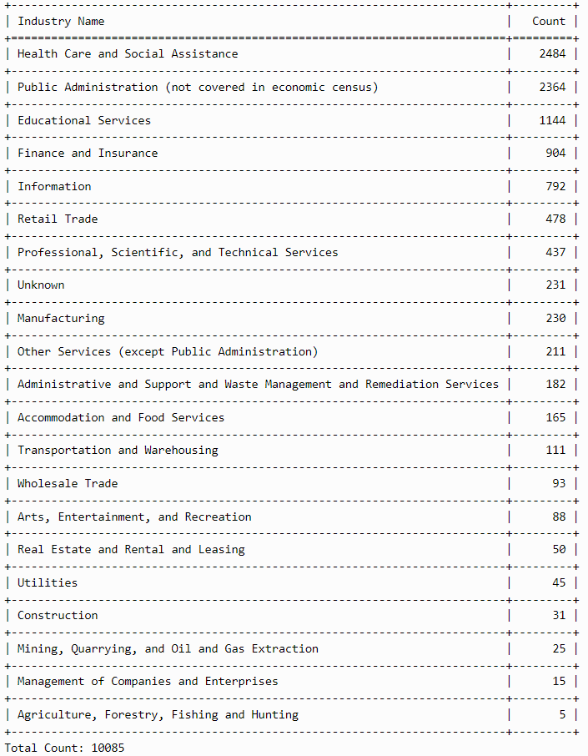
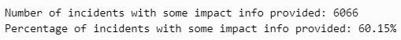
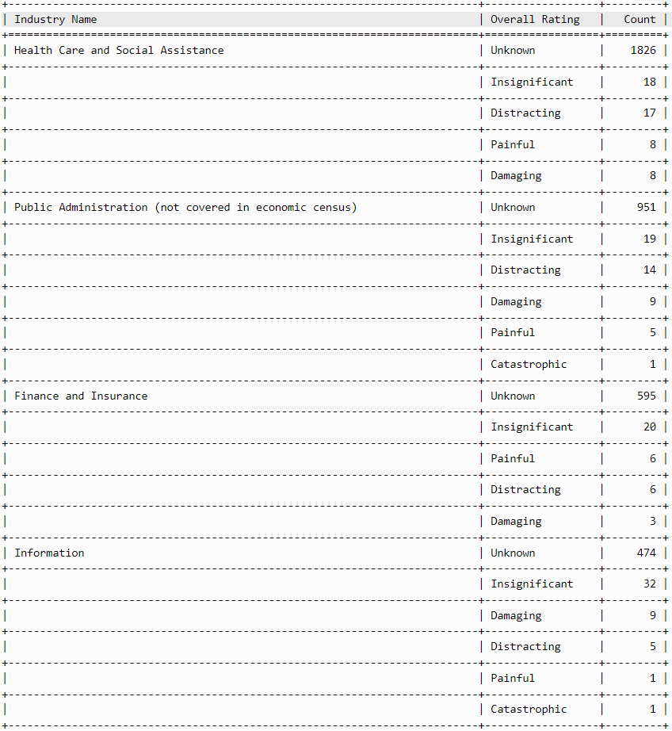
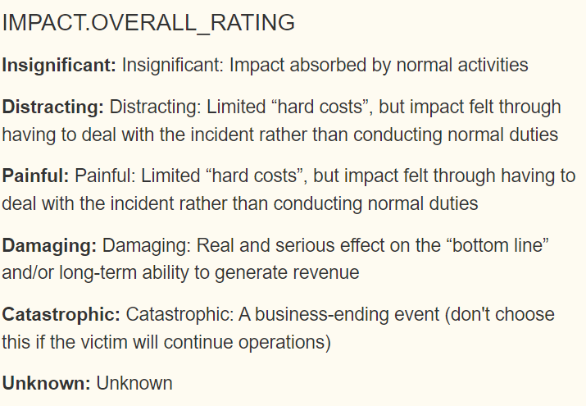
Initial Insights from VERIS Community Database
Stratification of the Frequency of incidents categorized by the Rating of Overall Impact of the incident on the organization, across Industries :
Attack Frequencies across Industries :

Slide 42
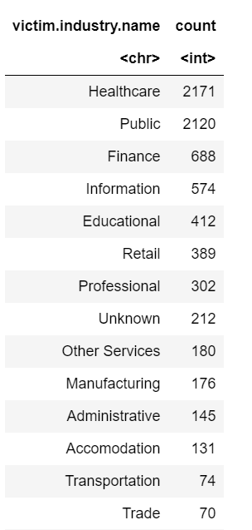
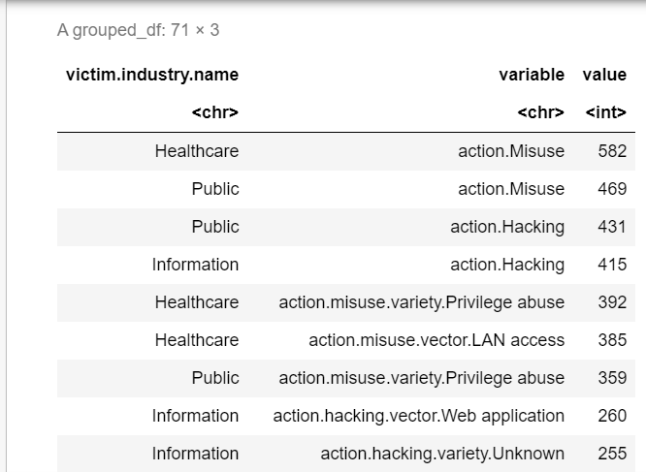
DATASET: final sub-datasets for objectives
OBJECTIVE: List the industries with the frequency of attacks
OBJECTIVE: List the top 3 types of attacks for each industry

Slide 43
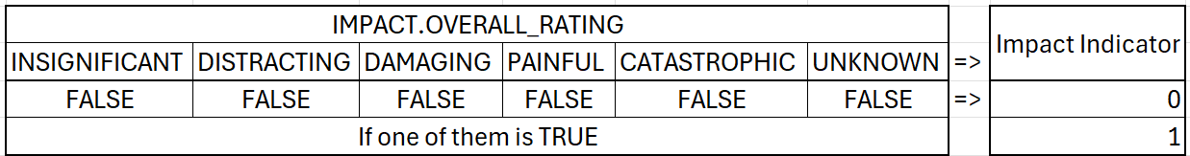

Exploratory data analysis
Impact Rate: Impact indicator/No. of Incident

Slide 44

Synthetic Data
“Synthetic data is data that has been generated using a purpose-built mathematical model or algorithm, with the aim of solving a (set of) data science task(s).”
Can Synthetic Data Replace Real Data?( i.e. Can we do the same things with/to synthetic data as with real data. ):
Hmm. It depends: Often there’s a tradeoff between Privacy & Fidelity. Conclusions drawn from data analysis and Statistical Hypothesis tests done on synthetic datasets tend to be weaker than when one on their real counterparts.
Promising use cases of Synthetic Data Generation:
Privacy Protection
De-biasing Datasets
Data Augmentation
Provision of a secure environment for research
How good your Synthetic Data is, depends on these data attributes:
Generative Models for generating Synthetic Data:
Utility
Fidelity
Privacy

Slide 45


Classifying Ambiguous Industry Labels into Defined Categories
Issues faced during Classifying:
Data Quality Issues.
Dataset Imbalance.
Inadequate Feature Selection.

Slide 46


Classifying Ambiguous Industry Labels into Defined Categories
Victim Industry names before classification
Victim Industry names after classification

Slide 47
DBIR REPORT
DBIR report analysis: "The Data Breach Investigations Report (DBIR) is an annual publication that analyzes security incidents and data breaches to uncover trends, understand threats, and provide insights on protecting businesses. To make sense of the vast amount of data they collect, the DBIR team uses the North American Industry Classification System (NAICS).
NAICS helps the DBIR to organize information by categorizing each victim organization into a specific industry based on their
primary business activities. This system uses series of codes ranging from two to six digits – the more digits, the more specific
the category.
EXAMPLE:
"Let's look at an example code from the DBIR to see how it connects to NAICS. The code '62' is used to represent the 'Health
Care and Social Assistance' sector. According to the DBIR, this sector often faces incidents involving Personal Health
Information (PHI) breaches.
The NAICS code helps the DBIR to categorize these incidents and analyze trends specific to healthcare organizations.
So when the DBIR reports on data breaches under the label 'Healthcare (62)', it's not referring to the number of incidents but
identifying all the data breaches that occurred within the healthcare sector, using '62' – the NAICS code for that industry."

Slide 48
The industries (sectors) analysis:
The document extract outlines various types of security breaches across different industries and their trends over time. Here's an assessment based on the provided details:
The Financial and Insurance sector: System Intrusion: Purple lines remain relatively stable but show an exponential increase after 2020.
saw a significant peak in System Intrusion incidents after 2020. This suggests that attacks on this industry's systems became more aggressive or successful, which could have severe implications due to the sensitive nature of financial data.
In Healthcare: Basic Web Application Attacks: The percentage of breaches caused by these attacks increased over time.
there was a notable peak in Miscellaneous Errors around 2018, then a decrease, but an increase in Basic Web Application Attacks over time. This may imply that while general mistakes are being better controlled, there's a growing trend in targeted attacks on healthcare web applications.
For the Information sector: Hacking: These breaches are depicted by purple lines. Their occurrence percentage remains consistently high throughout the years.
hacking (depicted by purple lines) remains consistently high, showing that this industry is a constant target, likely due to the valuable data it holds.

Slide 49

In Professional, Scientific, and Technical Services: System Intrusion: Shown in purple, these breaches have lowest in 2018, later it gradually increased. there has been an increase in System Intrusion breaches since 2018, suggesting a growing risk in this area.
Public Administration : Social Engineering: Light blue lines indicate social engineering breaches, which fluctuate but have the highest in 2017,2018 and 2020. showed a rapid increase in System Intrusion in 2021 and varied levels of Social Engineering incidents, highlighting fluctuating but significant threats in this sector.
The Retail sector: System intrution breaches increases since 2017 to 2021 Data suggests varied attack methods with no single dominant trend, indicating a need for broad security measures.

Slide 50

RISK ASSESSMENT FRAMEWORK

Slide 51

SMB cyber profiling method
What is SMB cyber profiling method?
Cybersecurity needs
Allocate resources
SMB Challenges
Limited data on cyber-attacks against each business
Lack of information on successful prevention measures
SMB Features
Different types of businesses
NAICS data
Decisions about protecting themselves
Threat/Hazard: The potential for a threat for a specific business type based on motivation.
Vulnerability: assesses where failures or exploits are likely to occur.
Consequence: the impact on data, such as data loss or deletion.
Risk = Threat x Vulnerability x Consequence ​

Slide 52

SMB cyber profiling method
Threat/Hazard: The potential for a threat for a specific business type based on motivation.
VERIS dataset
Actors affecting the industries
Group the attackers
Organizations
Feedback
Motives for attacking the industries
External countries
Hackers
State affiliated
Activists

Slide 53

SMB cyber profiling method
The Methodology: (Threat/Hazard)

Slide 54

SMB cyber profiling method
The Methodology: (Threat/Hazard)

Slide 55



SMB cyber profiling method
The Methodology: (Threat/Hazard)

Slide 56

SMB cyber profiling method
Consequence: the impact on data, such as data loss or deletion.
VERIS dataset
Confidentiality
Group the breaches
Actions
Feedback
The frequency of each type of breach per industry
Integrity
Availability
attributes

Slide 57


SMB cyber profiling method
The Methodology: (Consequence)
Actions such as "Exfiltrate," "Data theft," and "Data disclosure" were considered for confidentiality breaches. Integrity breaches were associated with actions like "Modify data files" and "Control of data processes," while availability breaches encompassed actions such as "DDoS attacks," "System encryption”.

Slide 58
RISK ANALYSIS model
FEATURES CONSIDERED TO ANALYZE RISK:
Actions: What sort of actions by the actor (adversary) affected the asset?
Assets: What sort of information, data, or resource was compromised?
Attributes: How did the actions impact the assets? What was the damage caused?
Impacts: How severe was the impact?
RISK
Attributes
Actions
Assets

Slide 59


SMB cyber profiling method
The Methodology: (Consequence)
For confidentiality attributes, "attribute.confidentiality.data_disclosure.Yes" was considered. Integrity attributes included a range of varieties such as "Alter behavior," "Created account," "Defacement," "Fraudulent transaction," and others. Availability attributes comprised varieties like "Degradation," "Destruction," "Interruption," and others.

Slide 60
Application of LorenZ Curves for Risk Profiling
Gini Index : (A)/(A+B)

Slide 61


Industry | Phishing | Malware | DDoS | Insider Threat | Ransomware
Banking | 100 | 150 | 50 | 30 | 70
Healthcare | 80 | 120 | 40 | 60 | 100
Retail | 90 | 110 | 70 | 20 | 60
For Each industry, Equitability of incidents across all the attack techniques:
For Each Attack Type(technique), Equitability of incidents across all the Industry Sectors:
Attack Technique
Frequency
Cumulative Percent%
Banking Sector
DDoS
Attack Technique | Frequency | Cumulative %
Insider Threat | 30 | 9.1%
DDoS | 50 | 24.2%
Phishing | 100 | 54.5%
Malware | 150 | 100%
Industry | Frequency | Cumulative %
HealthCare | 40 | 25%
Banking | 50 | 56.25%
Retail | 70 | 100%
Gini Index : 0.311
Gini Index : 0.125
Finally, develop a scoring methodology to score each attack techniques based on their contribution to Gini.
Finally, develop a scoring methodology to score each Industry Sector based on their contribution to Gini.

Slide 62
UPCOMING WEEK PLAN
Week-9 (13th March – 19th March):
Weekly meeting with the partner, Dr. Rasmussen. Presenting weekly updates
Continue analyzing risk using framework similar to SMB profiling and Lorenz's curve
Use census data to map the risks and visualize various industries across US

Slide 63

VERIS Community Database
Open-source data repository that was launched and is maintained by the Verizon RISK team which attempts to collate, compile and publish information of all publicly disclosed data security breaches.
The VERIS Schema includes variables for,
Incident Tracking, Victim demographics, Incident description(4As: Actors, Actions, Assets, Attributes), Discovery&Response, Impact Assessment, Indicators of Compromise.
{ "_id": { "$oid": "65c2dc46133020f62ff639b0" }, "action": { "error": { "variety": [ "Loss" ], "vector": [ "Unknown" ] } }, "actor": { "internal": { "motive": [ "NA" ], "variety": [ "Unknown" ] } }, "asset": { "assets": [ { "variety": "M - Documents" } ], "cloud": [ "Unknown" ] }, "attribute": { "availability": { "variety": [ "Loss" ] }, "confidentiality": { "data": [ { "variety": "Unknown" } ], "data_disclosure": "Yes", "data_total": 1 } }, "discovery_method": { "unknown": true }, "incident_id": "82E9BC33-ABF7-43AD-B6E8-DCB3505948BC", "plus": { "analysis_status": "First pass", "analyst": "swidup", "created": "2014-07-30T19:04:08Z", "dbir_year": 2014, "master_id": "82E9BC33-ABF7-43AD-B6E8-DCB3505948BC", "modified": "2015-02-13T16:50:36Z" }, "reference": "http://vcdb.org/pdf/va-security.pdf", "schema_version": "1.3.7", "security_incident": "Confirmed", "source_id": "vcdb", "summary": "A principal investigator reported to the Research Compliance officer that a research consent form containing an individual's full name and full social security number cannot be located.", "timeline": { "incident": { "day": 5, "month": 5, "year": 2010 } }, "victim": { "country": [ "US" ], "employee_count": "Over 100000", "government": [ "Unknown" ], "industry": "923140", "region": [ "019021" ], "state": "TX", "victim_id": "United States Department of Veterans Affairs" }}
An Example of an Incident Record from the VERIS dataset:
(JSON Format & Highly Nested)

Slide 64
ReferenceS
[1] Yuan, Y., Jiao, W., Wang, W., Huang, J., He, P., Shi, S., & Tu, Z. (2023, August 12). GPT-4 is too smart to be safe: Stealthy chat with LLMS via cipher. arXiv.org. https://arxiv.org/abs/2308.06463
[2] Mireshghallah, N., Kim, H., Zhou, X., Tsvetkov, Y., Sap, M., Shokri, R., & Choi, Y. (2023). Can LLMs Keep a Secret? Testing Privacy Implications of Language Models via Contextual Integrity Theory. ArXiv. /abs/2310.17884
[3] Esmradi, A., Yip, D. W., & Chan, C. F. (2023). A Comprehensive Survey of Attack Techniques, Implementation, and Mitigation Strategies in Large Language Models. arXiv:2312.10982. https://doi.org/10.48550/arXiv.2312.10982
[4] Montagna, S., Ferretti, S., Klopfenstein, L. C., Florio, A., & Pengo, M. F. (2023). Data Decentralisation of LLM-Based Chatbot Systems in Chronic Disease Self-Management. In Proceedings of the 2023 ACM Conference on Information Technology for Social Good (GoodIT '23), 205–212. Association for Computing Machinery. https://doi.org/10.1145/3582515.3609536
[5] Vidgen, Bertie ; Hannah Rose Kirk ; Qian, Rebecca ; Scherrer, Nino ; Kannappan, Anand ; Hale, Scott A ; Röttger, Paul arXiv.org, 2023 Simple Safety Tests: A test suite for identifying Critical Safety risks in Large Language Models. https://doi.org/10.48550/arXiv.2311.08370
[6] Neel, S., & Chang, P. W. (2023). Privacy Issues in Large Language Models: A Survey. arXiv:2312.06717v1. Retrieved from https://arxiv.org/abs/2312.06717
[7] WormGPT – The Generative AI Tool Cybercriminals Are Using to Launch Business Email Compromise Attacks July 13, 2023
Daniel Kelley
https://slashnext.com/blog/wormgpt-the-generative-ai-tool-cybercriminals-are-using-to-launch-business-email-compromise-attacks/
[8] agtecher. (2023). agri1.ai: A Two-Sided Approach to LLMs, ChatGPT in Agriculture - Frontend & Embedding and Domain-Specific Large Language Model for Agriculture. Retrieved from: https://agtecher.com/agrigpt-llm-2sided/ recobo. (2023). agriculture-bert-uncased · Hugging Face. Retrieved from: https://huggingface.co/recobo/agriculture-bert-uncased, Anwari, A. (2021). A Pre-trained Transformer Model for Agricultural Domain. Retrieved from: https://medium.com/@asanwari/a-pre-trained-transformer-model-for-agricultural-domain-81e70b4cb2bf, Quadros, V. (2021). BERT for Agriculture Domain. Retrieved from: https://medium.com/@vionaquadros/bert-for-agriculture-domain-f655d80c7da4
[9] Managing the risk of large language models in financial services. Quant University, Truera
https://truera.com/wp-content/uploads/2023/06/Managing-the-Risks-of-LLMs-in-FS-Industry-Roundtable-TruEra-QuantU-1.pdf

Slide 65

EDA
Distribution of Actors

Slide 66

Results
A total of 160 articles were published between June 2011 and February 2024
There are 102 Unique publishers and ‘Dark Reader’ published the most articles

Slide 67
Sprint 2: Dataset Collection
Incident Reports and Case Studies on LLM Attacks
Real-world LLM attack case studies highlighting vulnerabilities and threats across industries.
Industry-Specific Vulnerability Assessments
Dataset on Defense Mechanisms and Countermeasures
Identifies unique LLM vulnerabilities and risks within sectors like healthcare and finance
Details defense strategies and countermeasures for enhancing LLM security against attacks.

Slide 68

Dataset
Description:
VERIS dataset with over 2500 columns and over 7000 rows.
Enormous number of parameters, citing various entities within the dataset.
Performed data cleaning to eliminate redundant data information.
The process was performed in Jupyter Notebook using R language.
Discovered columns with summary and notes describing information about attack.
Further analysis to be performed on Excel to filter out year and unique values.

Slide 69


Data Cleaning Using R
Steps
Remove all unnecessary columns
Here cols "action.environmental" and "action.error" are not required
focus_cols as a vector containing two strings
starts_with() function with focus_cols to select columns from the dataframe df that start with either "action." or "victim.industry".
Dropping of columns
We then use subset() to remove the "victim.industry" column from df.

Slide 70


Data Cleaning
Steps
Retrieving the count of unique values within the dataset.
Removing the summary and notes column

Slide 71

DATASET: cleaned and reduced

Slide 72

Dataset

Slide 73




Web scrapping
Source
Tool
Outcome
HTML Website: The starting point of web scraping, where data resides.
Scrapping: The scripts and algorithms that navigate and extract data.
Structured Data: The valuable information collected for analysis and use.

Slide 74

Web Scraping
Utilizing Microsoft Bing News Search API
Setting up Azure Resource Group: The initial step involved creating an Azure Resource Group and a Bing Search resource, generating a crucial API subscription key for authentication.
Crafting a Python Script: A Python script was developed to issue HTTP GET requests to the Bing News Search API, using the requests library and targeting specific search parameters.
Data Parsing and Retrieval: The script parsed the JSON response, extracting vital details such as news titles, descriptions, URLs, and publication dates.
Data Organization into CSV: Employing the csv package, the data was organized into 'news_articles.csv', demonstrating the importance of structured data storage.

Slide 75

Web Scraping
Analyzing LLM Attacks:
Web Scraping News with Google RSS
Importance of News Articles: News articles reflect the zeitgeist, providing data for both trend analysis and public sentiment.
API Limitations: The limitations of available APIs, including cost and lack of historical data, necessitate an alternative approach.
Why Google RSS?: Google RSS offers a viable solution with its structured XML format and widespread use among news providers.
Project Methodology: Using the 'feedparser' library, we scraped news articles for occurrences of 'LLM attacks' and 'LLM vulnerabilities' to gather relevant data.

Slide 76

problem DESCRIPTION
Problem Statement :
”Large Language Models (LLMs) like ChatGPT and BARD are increasingly integrated across various industries, promising advancements in fields such as psychological counseling and medical diagnostics. However, concerns have been raised regarding the security vulnerabilities inherent in LLMs, including risks such as data theft and unauthorized access. To effectively utilize LLMs while mitigating potential security threats, it is imperative to conduct a comprehensive risk assessment. Despite existing research highlighting these vulnerabilities, there remains a lack of specific insights into which vulnerabilities pose the greatest risks and how they may impact different industries. Therefore, this project aims to assess the risks associated with utilizing LLMs for data security within industries, providing valuable insights to inform risk management strategies and safeguard sensitive information.”
Problem Context:
Domain of problem: Artificial Intelligence Security,Data Privacy,and Ethical AI.
Importance of problem: Addressing the security and privacy concerns in Large Language Models (LLMs) is critical for protecting sensitive data from unauthorized exposure, maintaining public trust in AI technologies, and ensuring ethical AI development that aligns with global data protection standards. This is essential not only for individual privacy rights but also for the broader integrity and responsible advancement of AI technologies.

Slide 77
Project goals
PROJECT GOALS
To add to the understanding of risks from LLM use by industry(sector or use-case), and identifying the associated attack vectors:
Develop a list of attack vectors, ease of attack (knowledge required, resources required), and attack effect using web scraping and other AI/ML techniques as appropriate to identify and collate different sources that provide the desired information.
Develop a list of industries and/or activities to compare and contrast LLM vulnerabilities.
Develop a method for assessing and comparing LLM attack risk between industries and/or activities.

Slide 78
LITERATURE SURVEY of INDUSTRIAL SECTORS
Industrial sector: 51 & 54- Computer Systems Design and Related Services
Cybercriminals are increasingly using WormGPT, an AI tool, for sophisticated Business Email Compromise (BEC) attacks, necessitating adaptive defense strategies and robust email verification processes. [7]
2. Industrial Sector: 11- Agriculture, Forestry, Fishing and Hunting
AI is revolutionizing the agriculture sector by enhancing productivity, enabling predictive analysis, promoting sustainability, and reducing labor costs. Tools like AgricultureBERT provide valuable insights from vast agricultural data. Initiatives like “agri1.ai” aim to further harness AI’s potential, developing specialized models like “agriLLM” to address agricultural challenges globally. [8]
3. Industrial Sector: 52- Investment Banking and Securities Intermediation
The use of Large Language Models (LLMs) in Financial Institutions (FIs) poses risks including data hallucinations, security breaches, IP violations, and potential bias towards end users based on demographic and financial status.[9]

Slide 79

CVE Dataset, filtered with relevant key words
Filtered dataset with key words to find relevant records related to Large language Models
Filtered since year 2020
Retrieved 69 records with relevant content, mainly describing errors in operations

Slide 80
Extracting Data
Method: A method we’ll be implementing to collect data for our risk assessment is the webscrapping technique.
Web scraping can be done manually, but it is often automated using software tools called web scrapers or crawlers.
Web scraping is widely used in various domains for purposes such as:
Market research: Gathering pricing information, product details, and customer reviews from e-commerce websites.
Lead generation: Extracting contact information from business directories or social media platforms.
Libraries to perform webscrapping:
Beautiful Soup
Scrapy
Selenium
FeedParser

Slide 81

SOLUTION ARCHITECTURE

Slide 82
SOLUTION ARCHITECTURE

Slide 83

Dataset
CVE DATASET
The dataset contains records of publicly disclosed cybersecurity vulnerabilities from 1999 to the present (2024).
(Cybersecurity vulnerabilities are weaknesses or flaws in software, hardware, networks, or systems that attackers can exploit to compromise the security of an organisation's information technology infrastructure.)
Important columns include Name (CVE ID), Description, and References.
The dataset contains both published records (220,000+) and reserved records (300,000+). Only published records contain descriptive data (description and reference).

Slide 84




problem Goals
In recent years, the adoption of Large Language Models (LLMs) has seen a huge spike among various industry sectors.
But these LLMs carry security vulnerabilities (privacy concerns, data theft, misinformation, phishing, etc.) that adversaries could exploit.
There is a significant lack of guidance to inform industries about these vulnerabilities.
Our goal is to devise a risk assessment framework to inform about the risk of LLM use across industries.

Slide 85

Exploratory data analysis
Timeline for attacks
Discovery takes most time,
Sometimes even year.

